Slide 1
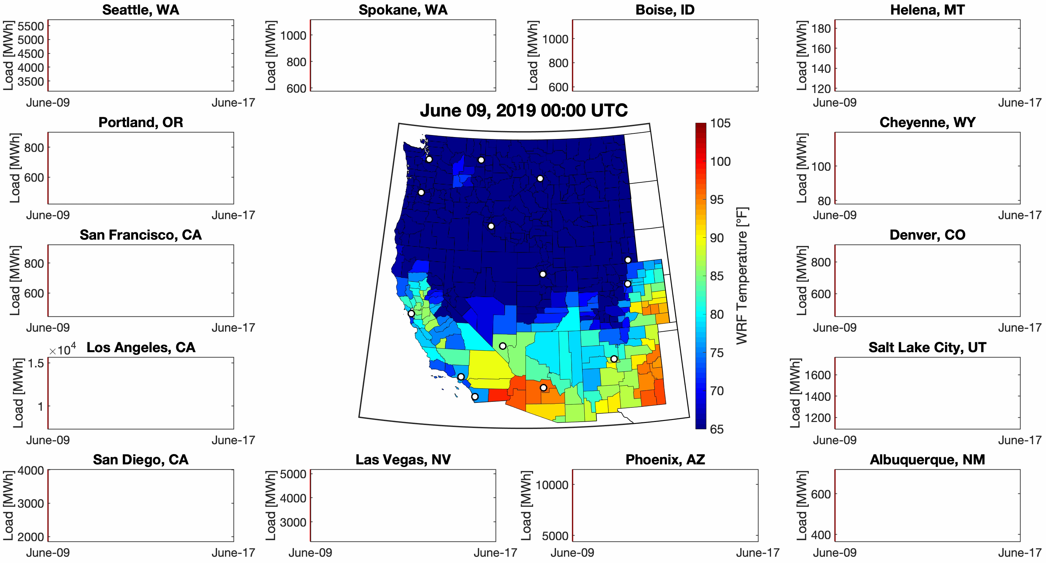
Map will show animation of temperature across western U.S. from TGW simulations. Full 12 km resolution using a mutually agreed upon projection.
Surrounding plots will have time series of loads in 3-4 key counties. Add a line for baseline load (e.g., average July load diurnal cycle). Could also show lines for solar and wind generation if we want to go there…could become a bit busy.
Layer on imports/exports of power across BAs from the GO model.
Part One: Baseline temperatures and loads
Messages
It’s important to simulate climate impacts on the grid
Highlight uniqueness of TGW approach.
Coupling ESMs with power system models to understand impacts

